Slide 1
Engineering
Induction Training Program
(E-ITP)
Project Management
Part 3

Slide 2
Project Tracking and
Control

Slide 3
Project Management Process
Define Scope
& Commit
Organization
Project Initiation & Start-up
Project Planning & Team Formation
Project Tracking & Control
Project Delivery & Support
Develop Plan
Execute Plan
Track and
Control
Deliver
Product and
Close Project

Slide 4
“Control” in Project Planning
In project planning the term control relates to comparing progress to plan so that corrective action can be taken when a significant deviation from planned performance occurs.
Information and data are the primary ingredient of control here… versus “power as authority” over people.

Slide 5

How does a project
get to be a
year late ?

Slide 6


ONE day at a time !
By Fred Brooks in
The Mythical Man-Month, 1975

Slide 7
Tracking - Why?
To minimize risk
To know and accept reality
To take proactive corrective action
To avoid fire fighting
To improve in a certain area, e.g.:
  Peer reviews
  In-process faults (IPF)
  Product quality

Slide 8
Tracking - Frequency
Typical frequencies
  Micro level (e.g. weekly)
  Macro level (e.g. monthly)
  Event based (on a when needed basis)
Hold regular project meetings

Slide 9
Tracking
Tracking will consist of
  Metrics collection
  Gantt charts update
  Meeting and status report
    Project status, milestones, IPF and action items

Slide 10
Tracking – Agenda
Agenda of the meeting
  Discussion on project status mainly to find out:
    Activities which may have escaped the planning
    Redundant activities
    Activities which may help other project teams

Slide 11
Tracking – Activities and milestones
Review milestones accomplished
Ongoing development status
  Review of work done
Upcoming milestones
  Major milestones for the next 4 weeks
  Activities for the next week

Slide 12
Tracking – Drivers for re-planning
Examples:
  Extra activities need to be planned
  Some activities need to be removed
  Schedule variance out of thresholds
  Resource re-allocation
  Change in the project objectives
The drivers are documented in the SPMP.

Slide 13
Tracking – Risks and goals
Risks tracking
  Review risks (planned and new), status and abatement plan
Status of chosen objectives (goals)
  Peer reviews
    Collect % of review done: (reviewed size/ready for review size)*100
    Investigate out of range behaviours seen in metrics

Slide 14
Tracking – IPF
In-process faults (IPF) tracking
  Review cumulative errors vs. goal
  Discuss the error trend (with respect to elapsed time and/or NLOC)
  Discuss the errors found. Arrange a separate CAM, if required. It is not needed to put these errors in the weekly status report.

Slide 15
Tracking – Action items
Review and update action items
  Review the status of pending action items
  Generate list of new action items
  Mark closed action items
  Retain pending action items in the status report
  Re-look at overdue action items

Slide 16
Tracking – Action items
Action item shall have at least three fields
  Description of the action
  Person responsible for closure
    An individual and not a group should be made responsible for an action
  Planned closure date
The Action Tracker tool is used to track action items.

Slide 17
Tracking – Charts
Collect effort, error and code size
Generate status charts
  Consists of Milestone, Schedule, Requirement volatility, and Risks
Generate Q-Data chart
  Effort, size, cycle time and faults

Slide 18
Tracking – Status summary
Summarize objective-based tracking
  Examples of this may include
    Product Quality (MIPS, Response time etc.)
    Benchmarking against competitors
    Tool usage report
Review within Operations
Present at Managing Director’s project review
Notes:
Project tracking is done at 3 levels:
Project level: PL in team meetings & WPR generation
Operation level: Ops Mgrs at WPR
Organizational level: Director and direct reports at Operation Review Meetings

Slide 19
Project Metrics
Projects should apply metrics in the following areas:
  Examining the status of issues and activities - problems, changes and progress of project activities
  In Project planning to assist estimation activities
  To measuring progress towards defined project goals
  Assessing the product attributes - quality, reliability, performance, maintainability
  Assessing process quality - effectiveness of quality gates, task selection, lifecycle and identification of non-value added activities
  Decision making - when to perform an activity, selection of the 'best practice' and evidence to support a process improvement
Notes:
These are the key areas in which metrics are used by projects.
Historical data is available to projects to support objective estimation activities.
Assessing process quality is done through a number mechanisms including audits and project reviews. At project reviews, Quality Gate Containment Effectiveness (QGCE) metrics are presented. This data is examined to determine whether the project is effectively use quality gates to find defects.
QGCE = # Errors / (#Errors + #Defects)
Typical values > 0.80
An example of metrics being used in decision making is in contract re -negotiation. There is a need to eliminate the level of subjectivity in re-negotiation as there is a potential to make the Customer unhappy. Objective rules need to be defined and agreed between different groups. For example, re-negotiate if requirements changes result in 10% more effort (compared with budgeted).
Project metrics feed into organizational metrics. This is called “Rolling up metrics”.

Slide 20
Project Metrics
Metrics collected:
  Quality data (cost of quality, errors/defects and their associated lifecycle activities
  Customer satisfaction
  Post-release and customer found defects
  Cycle-time (kick-off to release)
  Productivity (KAELOC/staff month)
Notes:
Q-data - cost of quality metrics, errors and defects with respect to lifecycle phases. Reported monthly by projects.
See example q-data on following page
Customer surveys - data collected from customer surveys

Slide 21
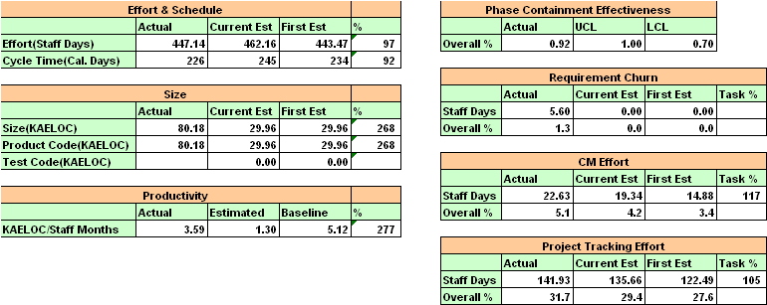
Summary data chart

Slide 22
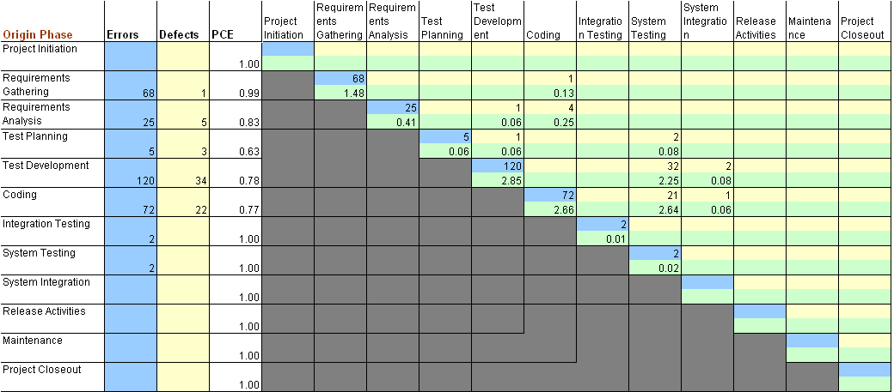
Q-Data chart
Notes:
Q-data matrix - reported once a month at project reviews
The matrix shows the cost of quality and how it relates to parts of the lifecycle
Analysis of the matrix looks at effectiveness of quality gates and may also highlight potential risks with artifacts generated in particular phases.
Example: If Quality Gate Containment Phase for coding phase is low (e.g. <0.70), the code may be of poor quality and it is likely that there are still more problems in code to be found.

Slide 23
Project Metrics - Examples
Estimation accuracy (size, schedule and effort)
  Effort estimation accuracy (EEA) = actual effort/estimated effort
    EEA > 1 => under estimate
    EEA < 1 => over estimate
    Goal EEA = 1 +/- 0.1
Product size (lines of code, pages)
Test Coverage / Test Results
  Line coverage, # test cases passed
Notes:
Estimation accuracy - comparison of actual against planned (first)
Change request metrics - tracked to investigate stability of requirements for project
Test coverage - adequacy of testing

Slide 24
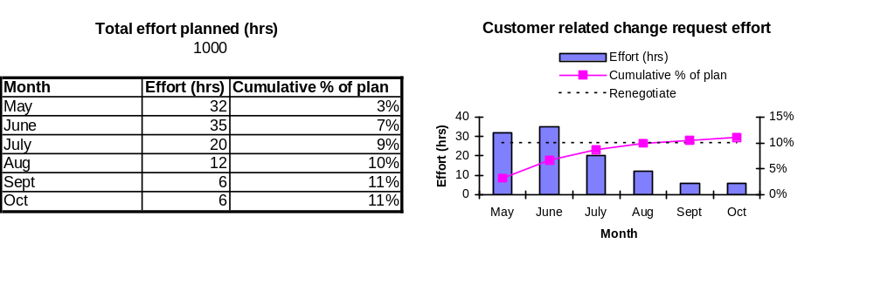
Project Metrics - Examples
Change request activity metrics
Notes:
Re-negotiation of contracts can be determined by a specified level of customer change requests (e.g. 10%), compared with the budgeted level of effort for the project. This may give a level of flexibility for minor changes by the customer, but major changes would require re-negotiation of price and schedule.
Metrics are integrated with tracking activities for projects.

Slide 25
Project Metrics - How?
Software Measurement Plan (SMP)
  Outlines standard metrics to be collected and used
    What/where/why not?
Software Quality Assurance Plan (SQAP)
  Inherits metrics from SMP
  Defines project specific metrics to be collected and used
  Sets project specific goals
Notes:
SQAP created and tailored by projects
Standard metrics - from metrics plan (to support organizational metrics/goals)
Project goals - defined based on organizational goals and Customer goals/requirements.
Example 1: Organizational goal of +/-10% estimation accuracy => project goal of at least or better (if feasible)
Example 2: Customer requirement of size < 20kB => project goal
Goals should be set base on some objective information
-Benchmarks
-Industry data
-Prototyping
Goals need to be achievable (SMART)
See Goal Question Metric Paradigm for further information.

Slide 26
Project Metrics - Where?
Metrics book (MBOOK) and IQMEn
  Project metrics repository
  Contains qualitative data
    To characterize the data collected
  Contains quantitative data
    The data collected
Notes:
Tailor MBOOK to satisfy metrics collection defined in SQAP

Slide 27
Project Tracking and Control
Project meetings
Customer conference calls
Project reviews
Project plan reviews
Preview meetings
End of activity checklists
Post-mortem meetings
Audits

Slide 28
Project Meetings
Schedule tracking
  Measure progress against scheduled tasks
  Allocate new tasks
  Identify and deal with potential problems (issues)
Time tracking
  Mandatory tool is Teamplay / Teamplayer
  Based on project WBS and/or project phases
Action tracking
  Allocate/monitor project action list
  Open, due and closed date for every project action
  Each action assigned to a named individual
  Include customer actions
  Actions can be raised at any type of meeting

Slide 29
Customer Conference Calls
Frequency agreed with customer (e.g. weekly)
Report progress, identify potential problems, allocate/monitor actions
Identify and manage
  Requirement change
  Schedule change
Conference minutes must be recorded (e-mail)
Customers may also require regular reports in a specific format

Slide 30
Customer Satisfaction Surveys
Talk and listen to your customer
  Format, number and timing agreed with Quality Engineer
    How do you get the best feedback from the customer?
  Customer completes survey
    Results stored in GSG mandatory tool
    Results allocated to organizational metrics

Slide 31
Project Reviews
Led by PL, TL, and other team members as required
Reviewed by Operations Manager(s) and other managers.
Project review reports include
  Project progress
  Red flags (issues and risks)
  Resource usage
  Quality metrics (project and product)

Slide 32
Milestone Reporting
Define milestones against the project deliverables
Report achieved milestones to appropriate management so they can understand how the projects play in financing the organization
Management with the finance role might charge the customer based on achieved milestones
A “milestone lunch” is a method by which project and organizational management discuss status at specific times in the project

Slide 33
Preview Meetings
Familiarize the team with new phase/activity
Deal with changes
  customers change
  requirements change
Re-assess current risks
Review and update project plans (re-plan)
  Trade-off functionality vs. schedule vs. budget
  Set phase goals, revise methods & tools
  Re-estimate and re-schedule
  Implement improvement recommendations from post-mortem results

Slide 34
Post-mortem Meetings
To capture the lessons learned
  Things well done
  Good practices
  Good tools
  Areas needing improvement
Process improvement
  Reusable items
  Reusable tools
Causal analysis
  Error/Defect analysis
Generate actions plans for improvement

Slide 35
Audits
Performed by the Quality Specialist with help from team members
Scope of audit
  Meeting minutes
  Review results
  Metrics
  Action tracking
  Change control
  Functional and physical configuration
Audit output
  In-Phase Audit Report
  Corrective Action Requests (CARs)
  Preventive Action Requests (PARs)

Slide 36
Project Delivery and Support

Slide 37
Project Management Process
Define Scope
& Commit
Organization
Project Initiation & Start-up
Project Planning & Team Formation
Project Tracking & Control
Project Delivery & Support
Develop Plan
Execute Plan
Track and
Control
Deliver
Product and
Close Project

Slide 38
Project Delivery and Support
Project deliverables
Delivery media
Post-delivery
Maintenance policy

Slide 39
Project Deliverables
Defined in the SPMP
Release procedures
  More reviews and audits than any other phase
  Errors becomes defects after Release
  Usually take longer than planned
Acceptance testing
  The moment of truth...

Slide 40
Delivery Media
Transcend (*)
  Fast
  Secure
  Limited window
Web
  On-line documentation
  Transparent and 24-hour availability
  Can be secure
  Easy and quick feedback
Notes:
(*) Transcend
a tool named for TRANsfer / SENd Data
widely used throughout Motorola
users transfer data to and from a central repository via a server/client electronic drop box
data is transferred from the user’s disk to the repository via a socket connection between the client and server
when a user “transcends” data he is given a randomly generated 8character keyword associated with the data transferred… the key word can be given to users who need to access the data - you cannot access the data without the keyword
the tool was release in 1994, it has thousands of users and runs on many platforms.

Slide 41
Post-Delivery
Delivery is not the end of the project. It is a phase change from development to maintenance and support.
Center Maintenance Policy
  A section in REQB template requires tailoring for the product and customer

Slide 42
Maintenance Policy
13.3 GSG-Argentina Maintenance Policy
This section shall identify all maintenance requirements for the product released. Mode of problem reporting, contact person requirements. Norms for responses to problems, may be discussed here, if desired by the stakeholder.
The project manager at GSG Argentina shall be available via email, facsimile or telephone to answer questions concerning the delivered product for a period of six calendar months from the date of first delivery.
GSG Argentina shall repair any defects found in the delivered product at no charge for a period of 90 days or as defined in the MOU from the date of first delivery.
If support is required after this six month period has elapsed, GSG Argentina shall negotiate a maintenance contract with the stakeholder who will cover issues such as repairing defects, the additions of enhancements and answering questions.
Defects shall be classified into two levels of severity by GSG Argentina in consultation with the stakeholder.
A defect that renders the product unusable, including loss of mayor functionality, shall be classified as severity 1 defect and a new release of the product shall be produced to repair that defect,
Any other defect shall be classified as severity 2 defect, and shall be repaired in a later release of the product to be determined in consultation with the stakeholder.
GSG Argentina shall not support a version of the delivered product which has been superseded by the release of a new version unless an earlier version is covered by an existing maintenance agreement.
Scheduled releases of the product shall occur at a time agreed with the stakeholder, but not more frequently than at six calendar months (with the exception of the release to repair severity 1 defects)
The MOU data related to Maintenance Policy shall also be incorporated in this section. The content of the MOU might be different than what is stated here. If it is the case, the MOU has precedence and the Requirements Book has to reflect it.
Note: Extracted from GSG-Argentina REQB template v2.0.0.
Identifies:
  method of reporting
  problem classes
  contact information
  support conditions
    without charges
    with charges
  other requirements

Slide 43
Final thoughts

Slide 44

Three top factors for project success
Monitoring & Feedback
Project Mission
Communication
Reported by MIEL, 1999
Notes:
MIEL worked with a consultant to provide additional training in project management and found that these areas, related to understanding what the purpose of the project was, monitoring status and feedback to control the project, and overall communication were top factors for project success…
What others have you found to be important in your experience… what factors have you found important in you ITP projects?

Slide 45

Causes of Project Failures
Failure to properly define the problem
Planning was based on insufficient data
Planning was performed by a planning group
Project not tracked against plan
Project plan lacked details
Resource planning was inadequate
Project estimates were best guesses, made without consulting historic data
No one was in charge

Slide 46
Project Management Process Review
Project Initiation & Start-up
  Identification of customer/market, Feasibility study, Project proposal, Negotiation, Project start-up
Project Planning & Team Formation
  Project infrastructure, Team formation, Major activities, Key project documents, Project plan sign-off
Project Tracking & Control
  Weekly project meetings, Customer conference calls, Monthly project reviews, Preview meetings, End of activity check list, Project Plan reviews, Audits, Postmortem meetings
Project Delivery & Support
  Project deliverables, Delivery media, Maintenance policy, Beyond delivery

Slide 47
Session Goals Review
Achieve basic understanding of project management (Project Management Introduction)
  What is Project Management?
Explain the project roles & responsibilities (Project Roles & Responsibilities)
  Who does what and when?
Create an awareness of how projects are managed (Project Management Process)
  Stages, processes, project teams, interfaces, activities, artifacts
Sources for project support (Project Support Roles)
  Who, what, where, and how?

Slide 48
Project Management Process
Questions ?
Comments?

Slide 49
Backup slides:
Project analysis example

Slide 50
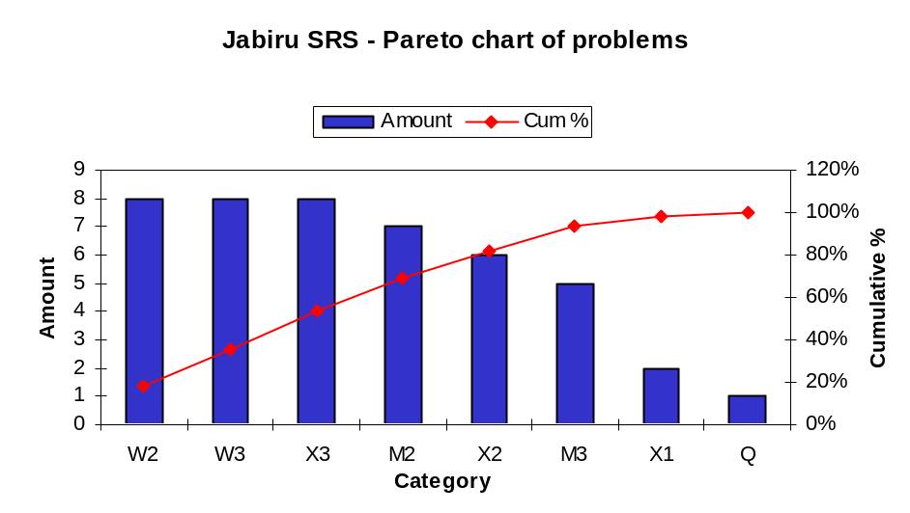
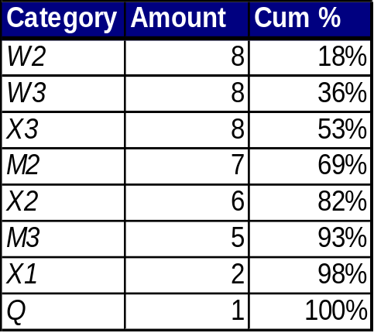
Jabiru SRS - Pareto analysis
W2, W3, X3, M2 categories account for 80% of problems
Notes:
Pareto Process
1. Gather frequency/sum of issues for each category
2. Sort by greatest to least frequently occurring
3. Calculate the cumulative percentage for the sorted set, based on the total of all categories
4. Plot using a combination chart, the actual numbers and cumulative percentage against category
5. Identify the categories which lie below the 80% level (from cumulative percentage)
6. Perform root cause analysis on the identified categories.
Category meanings:
W = Incorrect
X = Redundant/unnecessary information
M = Missing information
1 = Catastrophic; 2 = General; 3 = Cosmetic

Slide 51
Jabiru SRS - Fish Bone diagram
HUMAN
MACHINE
Misunderstanding 1
Too much detail 1
Redundant 3
Oversight 4
Lack clarity 6
Insufficient (trace) analysis 12
W2
W3
X3
M2
Inconsistent 2
MATERIAL
METHOD
** W2, W3, X3, M2 are error categories for errors found in review
Notes:
Potential sources of causes identified (human, material, machine, method)
Problems traced down to their root cause.
Data indicates human error is the main source of problems - indicates a high level of process maturity
A lack of trace analysis was the main source of errors

Slide 52
Jabiru SRS - Root causes
Largest category - insufficient (trace) analysis
  Used tool to generate RTMX from SRS and REQB, but tool did not check validity of referencing
Notes:
Need to ensure action is taken.
Since the cause of the problem is human, preventive solutions may be:
1. Training
2. Improved development guidelines
3. Tools that enforce checking of these problems
Look for most appropriate preventive action to ensure that this problem does not recur.

Slide 53
Backup slides:
Resources

Slide 54
Project Management Resources
This presentation contains materials from the following sources:
  Software Production Process, Motorola Australia Software Center (MASC)
  An Introduction to MASC Project Management, MASC ITP, February 1999
  Awareness About Project Management, Nirmal Kumar Sancheti, Sanjay Chitnis, Jayanth K., MIEL, Version 1.1, March 1999

Slide 55
Project Management References
This following references support the presentation materials and subject area:
  Managing Projects in Organizations: How to Make the Best Use of Time, Technologies, and People, J. Davidson Frame, Jossey-Bass, 1995
  Controlling Software Projects: Management, Measurement, and Estimation, Tom DeMarco, Prentice-Hall, 1986
  Guide to PMBOK, Project Management Institute, 1996
  Evo: The Evolutionary Project Manager’s Handbook, Manuscript MINI VersionTom Gilb, 1997

Slide 56
Change Control
Requirements ALWAYS change
Management of change is an essential part of project control
Effective requirements traceability and configuration management are essential
CCB (configuration control board)
  PL, TL, CM, STE, and QE
  oversees all major changes
Minor changes use TAF (test-analyse-fix)
Anticipate change, design for change where possible

Slide 57
Change History
Vers. A.1 July 2001
  New format and revision E-ITP PM Week 1 from prior source materials
Vers. A.2 06 September 2001
  Updated format
Vers. A.3 06 September 2006
  Gabriel Montes: Merged last topics of Part 4 into Part 3. Reorganized, updated and deleted slides.
Vers. A.4 18 October 2006
  Gabriel Montes: Minor cosmetic changes.

